Slide 1
INDIAN INSTITUTE OF INFORMATION TECHNOLOGY, ALLAHABAD SOFTWARE ENGINEERING (SE) BIG DATA ANALYTICS LAB 4TH SEMESTER C3 MINI PROJECT
1. IIT2021131 - HARSH SHARMA SUBMITTED TO - DR. SONALI AGARWAL MAM
2. IIT2021152 - SUMIT PRAKASH UNDER TA’S - ASHUTOSH KUMAR SIR
3. IIT2021153 - ARYAN PANDEY AMIT KUMAR SIR
4. IIT2021162 - SARANSH YADAV
5. IIT2021163 - SARANSH GUPTA
6. IIT2021191 - KUSHAGRA JAIN

Slide 2
TASK - CREATION OF BIG DATA ANALYTICS LAB WEBSITE
Abstract
The BDA Lab website is designed to provide a centralised location for all information related to Big Data Analytics. It serves as a hub for researchers, students, and professionals to explore various projects, access publications, and find resources related to big data analytics.
The website is built using modern web technologies such as HTML, CSS, and JavaScript. It is designed to be highly user-friendly, ensuring a seamless browsing experience. It uses MondoDB database.

Slide 3
TASK - CREATION OF BIG DATA ANALYTICS LAB WEBSITE
Technologies used -
HTML, CSS, JAVA SCRIPT, MongoDB
Project Tasks-
SRS, SDS, Use Case, Traceability Matrix, ER diagram, Video showing demo of the website.

Slide 4
TASK - CREATION OF BIG DATA ANALYTICS LAB WEBSITE
Functional components of the project-
User / Author and Admin are able to sign in. New users can sign up on the website.
User can search for projects and publications of a particular person.
On the author page, all the projects and publications of author is displayed.
Admin can add or delete projects, courses and publications.
New publications can be added by filling a form.
All the data displayed is dynamically fetched from the database.

Slide 5
USE CASE DIAGRAM

Slide 6
USE CASE DIAGRAM
A use case diagram is used to represent the dynamic behaviour of a system. It encapsulates the system's functionality by incorporating use cases, actors, and their relationships. Following are the purposes of a use case diagram given below:
1. It gathers the system's needs.
2. It depicts the external view of the system.
3. It recognizes the internal as well as external factors that influence the system.
4. It represents the interaction between the actors.
Extend relationship: The use case is optional and comes after the base use case. It is represented by a dashed arrow in the direction of the base use case with the notation <<extend>>.
Include relationship: The use case is mandatory and part of the base use case. It is represented by a dashed arrow in the direction of the included use case with the notation <<include>>.

Slide 7
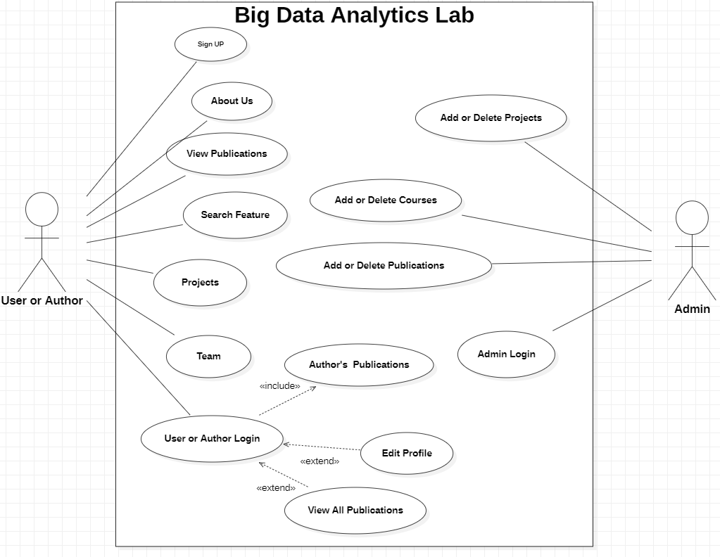
USE CASE DIAGRAM
Here, “User/Author” and Admin are the actors.

Slide 8
ER DIAGRAM
An E-R model is usually the result of systematic analysis to define and describe what data is created and needed by processes in an area of a business. Typically, it represents records of entities and events monitored and directed by business processes, rather than the processes themselves.
It is usually drawn in a graphical form as boxes(entities) that are connected by lines(relationships) which express the associations and dependencies between entities

Slide 9
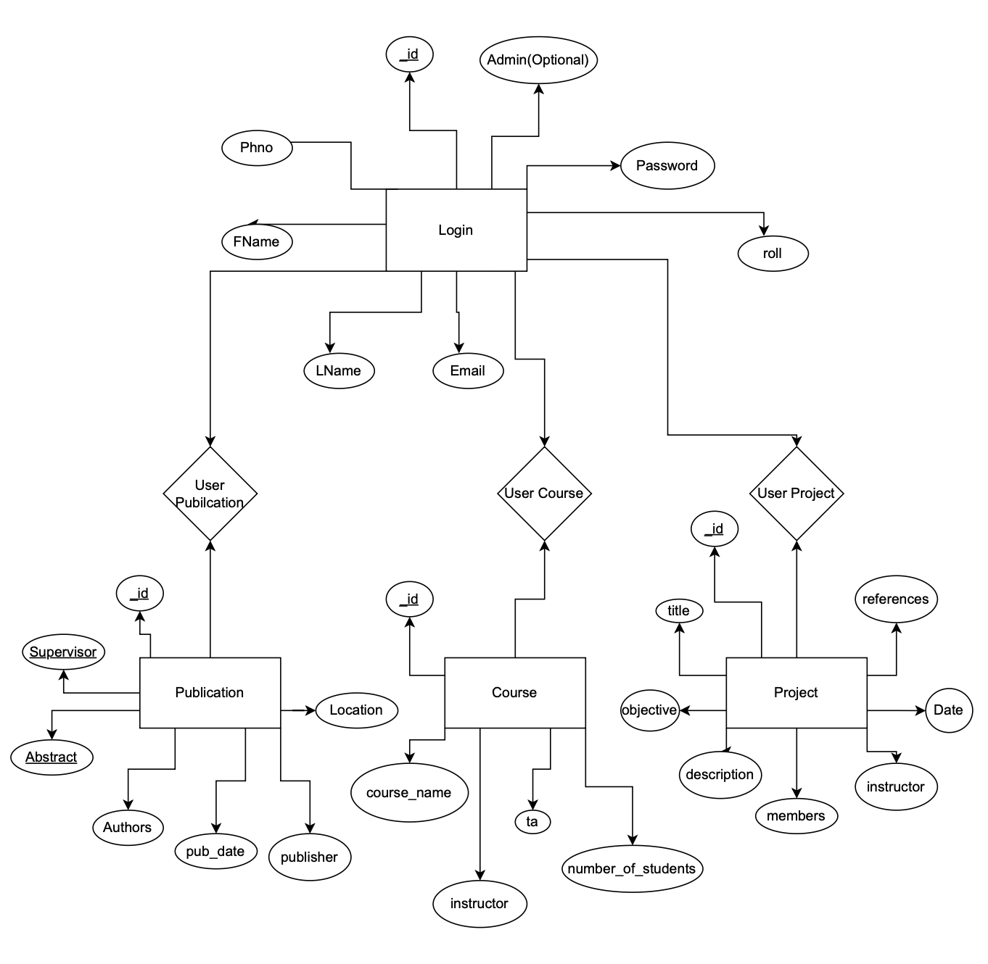
ER DIAGRAM

Slide 10
TRACEABILITY MATRIX
In software development, a traceability matrix is a document, usually in the form of a table, used to assist in determining the completeness of a relationship by correlating any two baselined documents using a many-to-many relationship comparison.
It is often used with high-level requirements and detailed requirements of the product to the matching parts of high-level design, detailed design, test plan and test cases.
A requirements traceability matrix may be used to check if the current project requirements are being met, and to help in the creation of a request for proposal, software requirements specification, various deliverable documents, and project plan tasks.

Slide 11
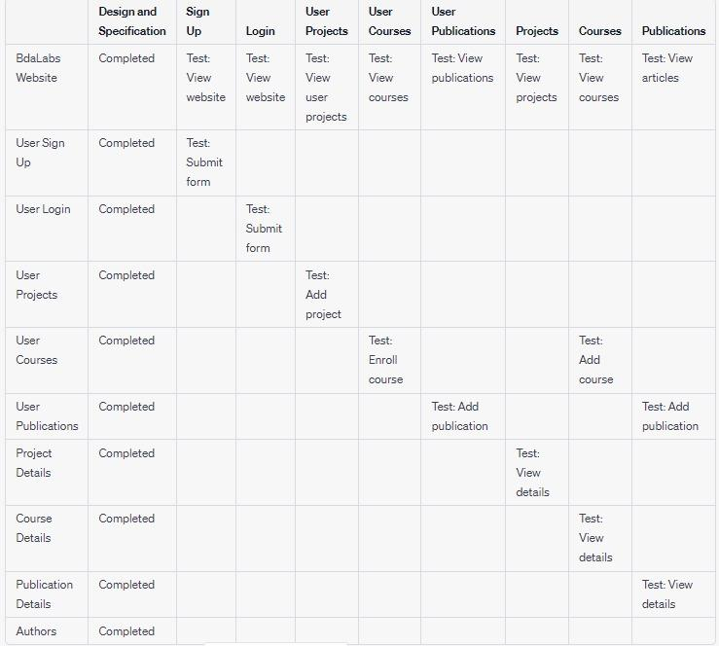
TRACEABILITY MATRIX

Slide 12
FUTURE SCOPE
1. We can conduct workshops where researchers from different colleges can register and attend it.
2. We can add tutorials and resources from where interested people can learn more about data analysis.
3. We can add payment gateway link for paid workshops and events.

Slide 13
VISUALS FROM THE LAB
WEBSITE

Slide 14
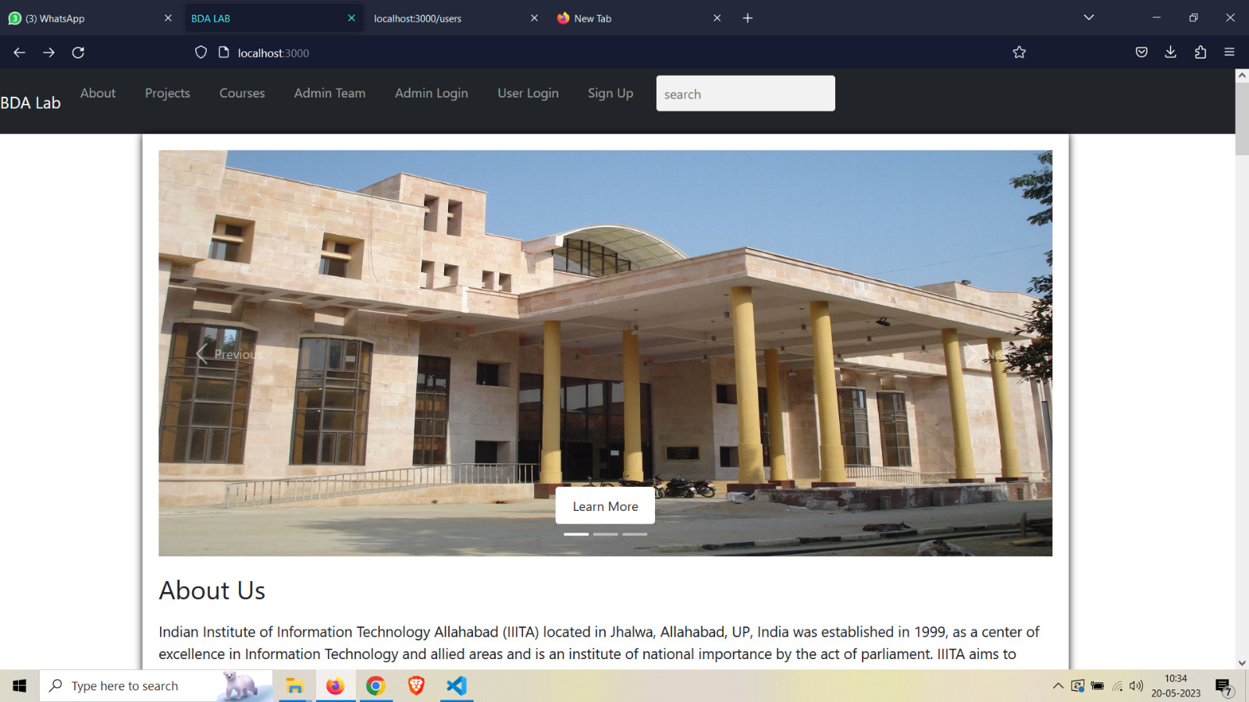
HOME PAGE

Slide 15
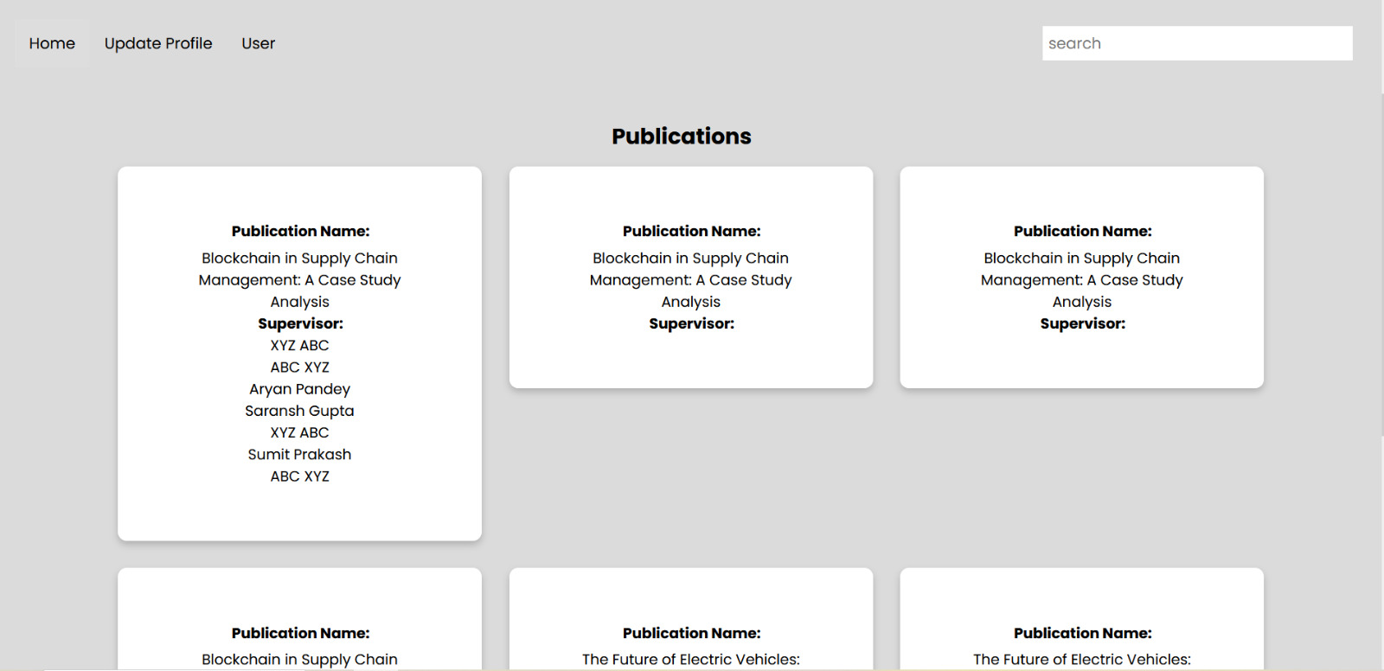
USER PAGE

Slide 16
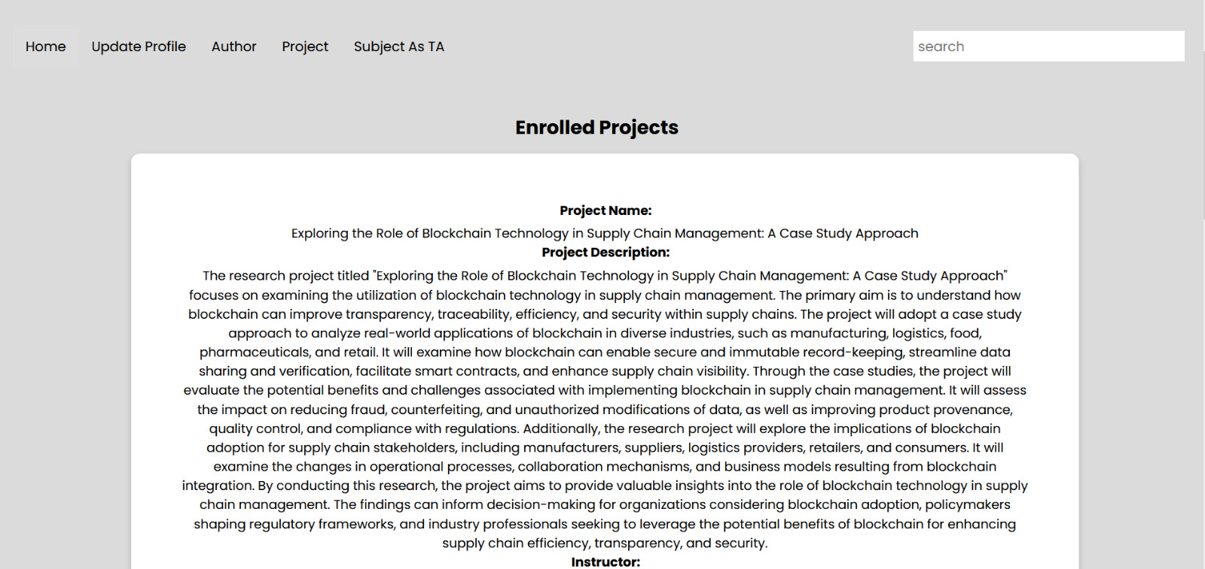
ENROLLED PROJECTS

Slide 17

ENROLLED COURSES

Slide 18
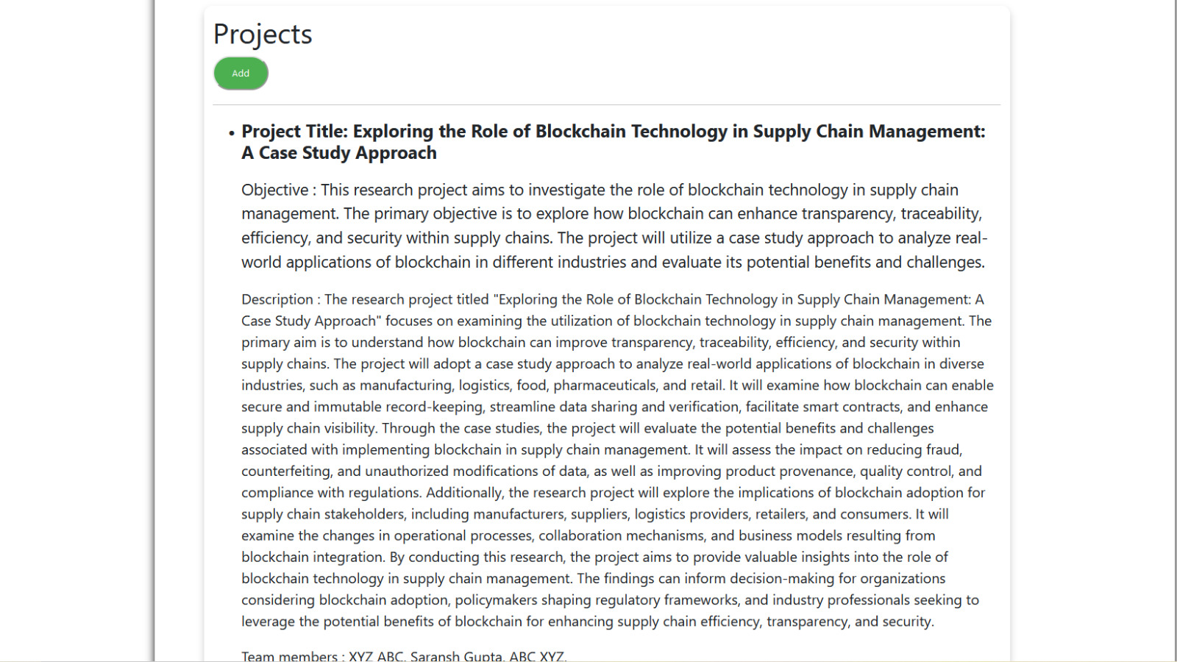
ADMIN PAGE

Slide 19

ADMIN PAGE

Slide 20
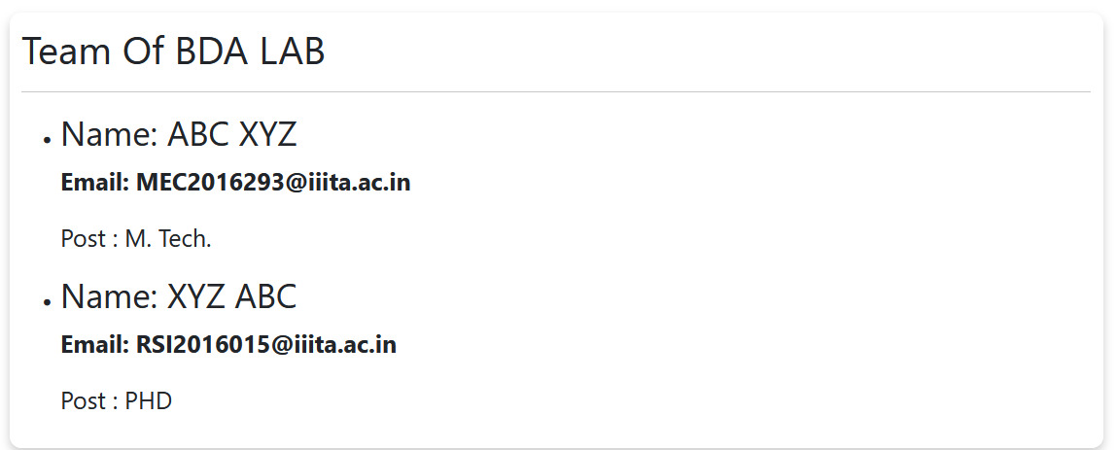
TEAM

Slide 21
THANK YOU

